Slide 1
A Primer on FPGAs (Field Programmable Gate Arrays) Taylor Riggan (@triggan)

Slide 2





Thank Our Sponsors
Platinum Sponsors

Slide 3



Thank Our Sponsors
Platinum Sponsors

Slide 4




Thank Our Sponsors
Gold Sponsors

Slide 5
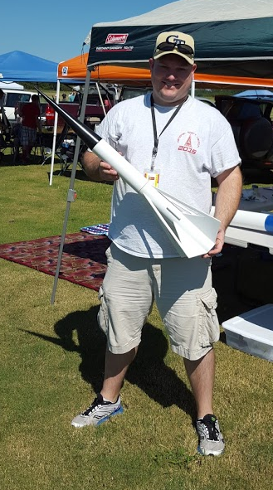



About Me
Hobbies: Maker, High-Power Model Rocketry, Building & Flying Drones
Contact Info:
http://www.waflhouse.com
@triggan on Twitter
github.com/triggan

Slide 6
Agenda
What is an FPGA? Basic architecture
FPGAs and their use by cloud service providers
Use cases and application
Where do you get started / tool chain

Slide 7
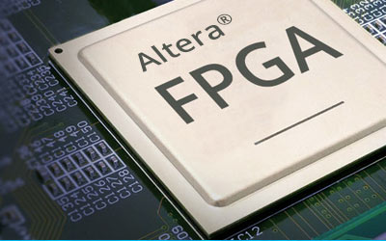
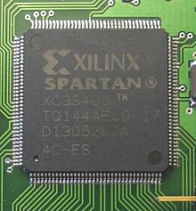
What is an FPGA?
Field Programmable Gate Array
“Field Programmable” – architecture can be changed after deployment (mostly).
Gate Array –
Gate – Short for a transistor logic gate. Most common form is a NAND gate. Chain together to create Transistor-Transistor Logic circuits (TTL).
Array – a whole lot of them.

Slide 8
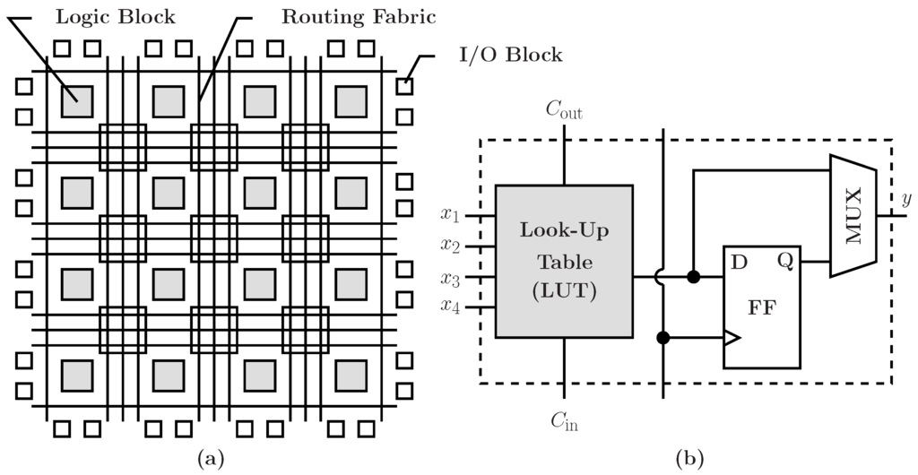
What is an FPGA?
“Sales-splaining”
An integrated circuit – a “chip”
Programmable logic – not really a bunch of logic gates; composed of lookup tables and some other components.
[mdpi.com]
Notes:
Made up of Configuration Logic Blocks (CLBs) along with programmable routing between CLBs. CLB shown in right side image.
Components – CLBs, Configurable Routing, Tons of I/O blocks (lots of these chips are BGA (ball grid array) – machine soldered only), PLLs – increase clock speed from 20Mhz up to near 1Ghz

Slide 9
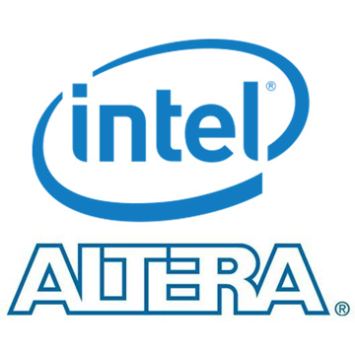


Current Market / Manufacturers
95% of market comprised of these 3. Many other niche players.
Xilinx is the market leader (50%)
Intel/Altera (39%, but gaining ground with Intel acquisition)
(purchased for $16.7B in 2015)

Slide 10
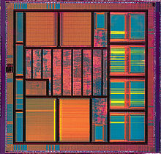
An ASIC without the mess…
ASICs – Application Specific Integrated Circuits – custom designed and printed silicon.
Susceptible to low yield rates some times.
No one wants to do VLSI (Very Large Scale Integration) chip layout.

Slide 11


Why an FPGA vs. CPU or GPU
CPUs designed for speed, but not necessarily efficiency. Built for general purpose workloads.
FPGAs and GPUs designed for high-throughput and efficiency, although may have lower clock speeds.

Slide 12
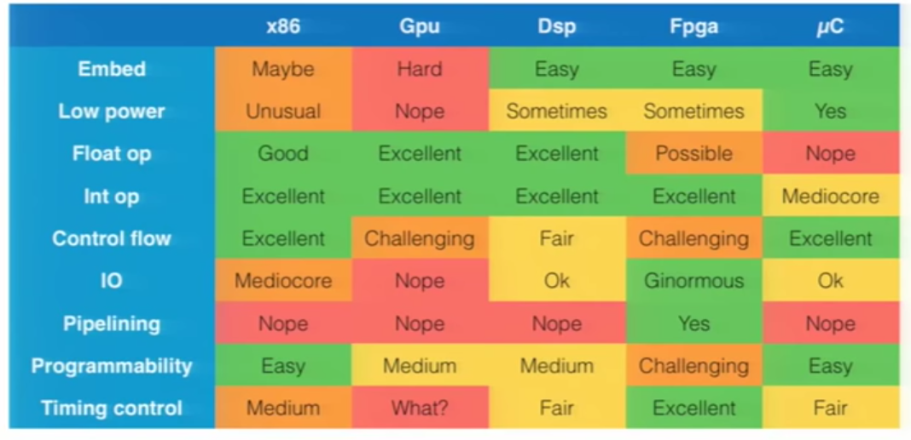
CPU vs. FPGA vs. GPU vs. uC
[FPGAs 101 – 30c3 (Chaos Communications Conference)]
Notes:
CPUs and Microcontollers – good at doing things that don’t repeat very often. Built for sequential operations, not necessarily parallel ops. CPUs built for large complex operating systems – handle many different processing threads.
DSP – not really built for general use case – very specific.
GPUs – Great at tough math problems (BitCoin mining); but difficult to use otherwise.
Combinations of these can be very powerful…

Slide 13
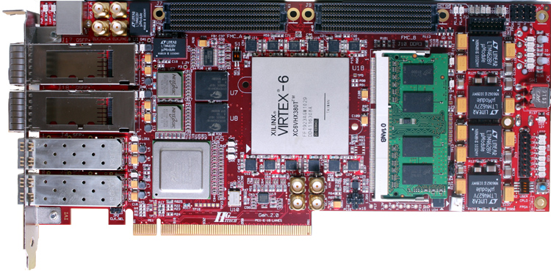
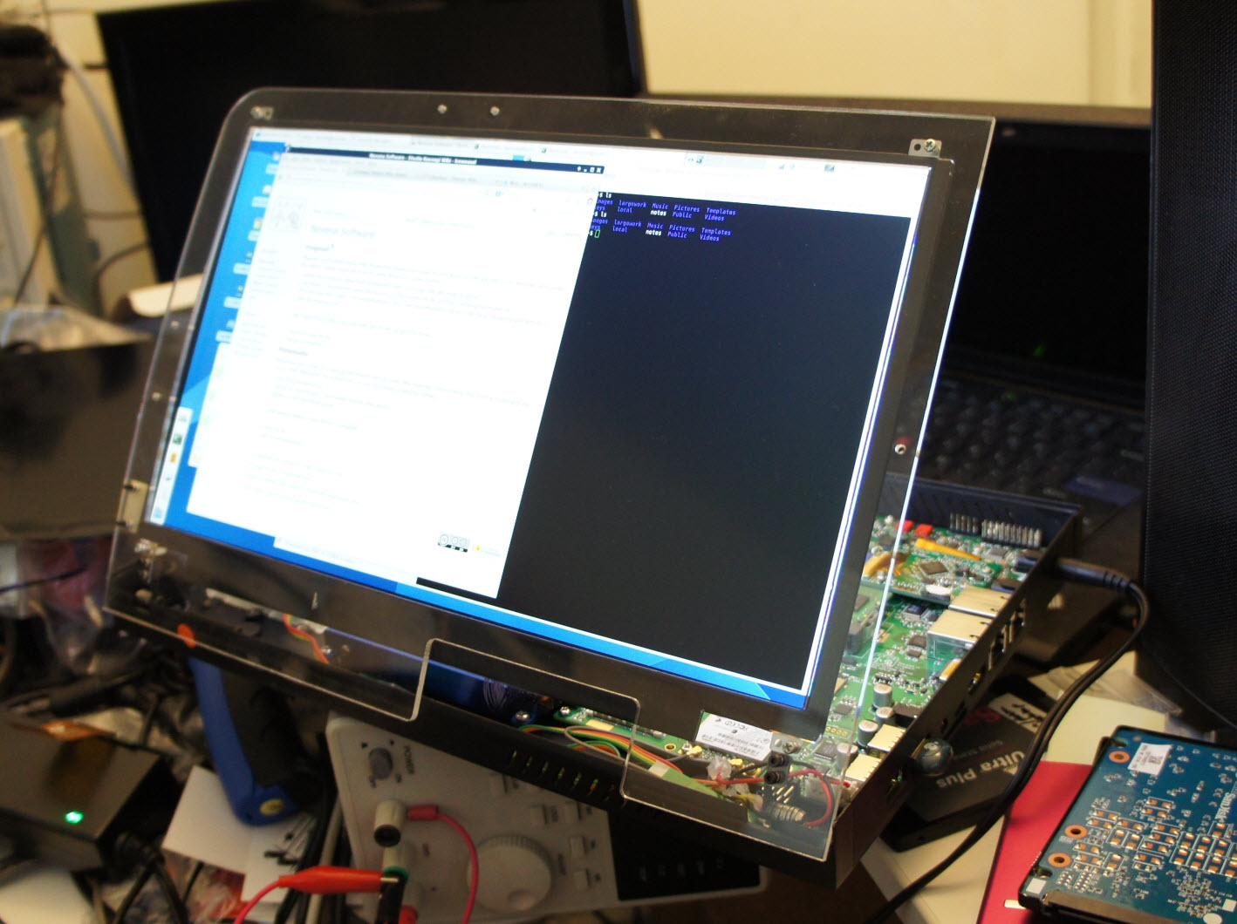
Combining FPGAs w/ x86 Architecture
Novena Laptop
PCIe FPGA Cards
Notes:
FPGA PCIe cards are relatively inexpensive – starting around $200-300. About the cost of a decent graphics card. I/O interfaces vary. Most form factors are built for Network Connectivity (lots of use cases in the form of network/packet manipulation).
Novena laptop – Bunnie Huang (first to crack Xbox encryption). Bunnie is THE hardware geek. Done talks on reverse engineering microcontrollers in SD Cards. Also used an FPGA for HD video manipulation (more on that in a bit).
Heterogenous systems are really what we’re seeing more of today. Cell phones and mobile devices do this very well –combination of microprocessors and microcontrollers. CPUs handle a lot of the control functions and operating system overhead while FPGAs are doing application specific functions. Best of both worlds.

Slide 14
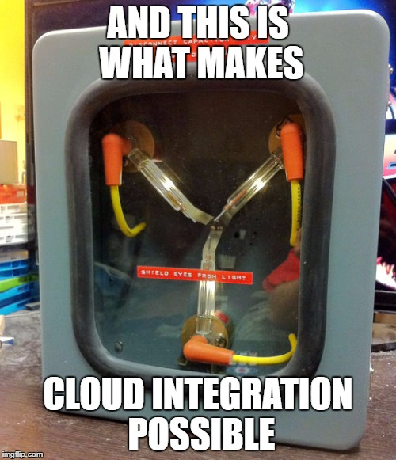
Notes:
Most hyperscalers are using FPGAs in this form factor – integrating them into x86 platforms. Not custom built appliances.

Slide 15
Cloud Adoption – Use Cases
According to Intel executive vice president Diane Bryant, a third of all servers used by major cloud providers will utilize FPGAs by 2020.
Notes:
Adoption of FPGAs by hyperscalers is picking up at a break neck pace. Moore’s law is on life support, if not already dead. We have to find other means to accelerate applications.

Slide 16
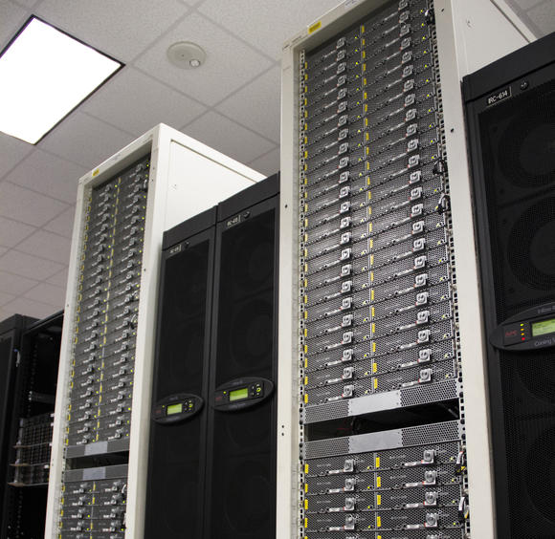
Microsoft Project Catapult
Started 2010
Originally targeted to accelerate Bing search queries.
Now used for a number of different use cases.
FPGAs deployed in nearly every production server within Bing and Azure – known as the “Configurable Cloud”.
Microsoft also partnering with Baidu in China to bring FPGAs to their datacenters.

Slide 17
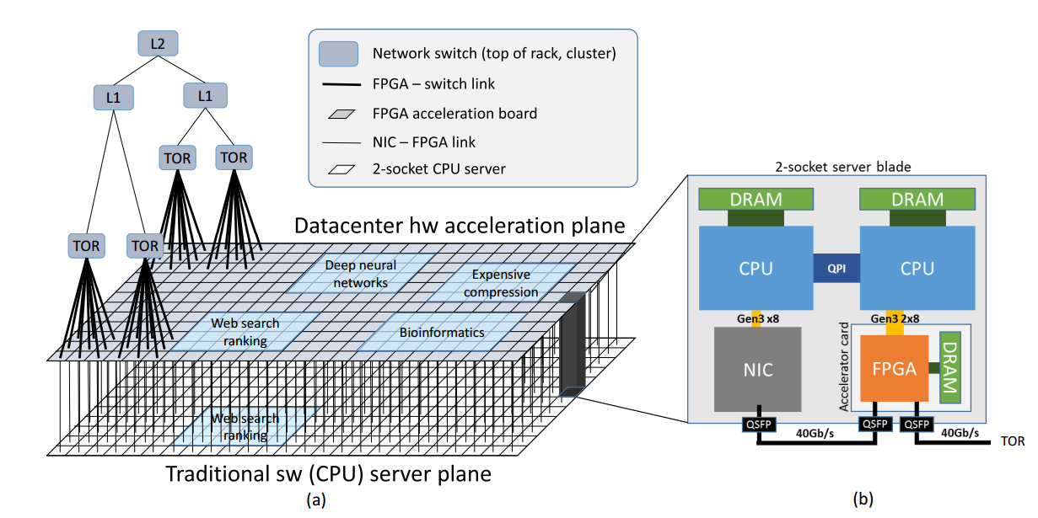
Microsoft Project Catapult
FPGA inserted on PCIe bus with “loopback” connectivity of Network Interface Card. All network traffic flows through FPGA.
FPGAs from different servers connected into a “Torus” of 48 FPGAs.
FPGA-to-FPGA communication enables future functionality in the deep learning and AI space; neural networks.

Slide 18
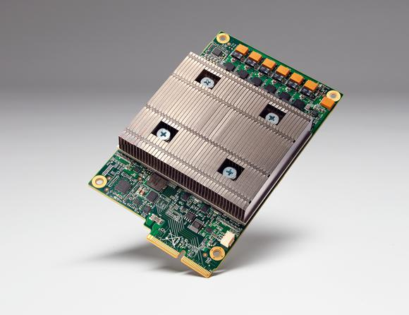
Google TPUs
Tensor Processing Units
Went different route – developed their own ASICs
Claimed FPGAs were too power hungry
Also connected via PCIe interface, but not directly network connected
Tailored specifically for Machine Learning. (TensorFlow)
Architecture still a closely guarded secret within Google.

Slide 19
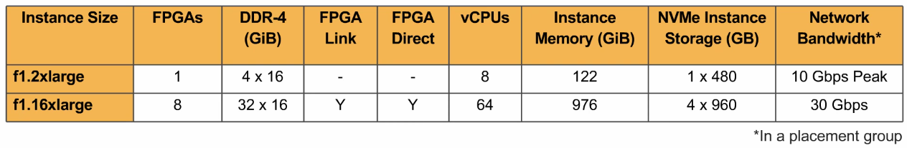
Amazon EC2 F1 Instances
Built for end-user consumption
Currently in preview since Dec. 2016
Development Tools available via AWS Marketplace
Built on Xilinx Ultrascale+ FPGAs
F1.16xlarge – similar architecture to Catapult – both PCIe and bi-directional link connectivity between FPGAs
2M Logic Cells per FPGA!!
Notes:
Spartan-6 that I have has just shy of 10,000 logic cells.

Slide 20
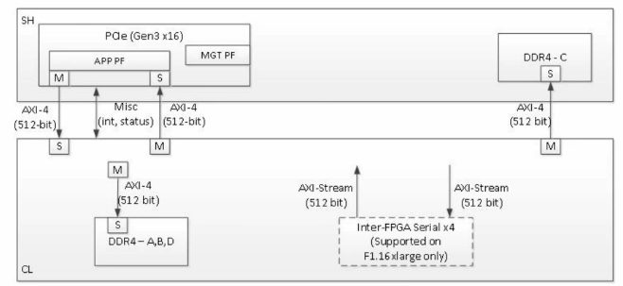
Amazon EC2 F1 Instances
AWS pre-configured FPGA shell – makes I/O access to FPGA much easier
Pre-built AFIs (similar to existing AMI images) – offers the ability to create a library of FPGA configurations. Also offer another security layer – bit-stream is encrypted.
Notes:
Typically accessing an FPGA via PCIe has been a bit cumbersome. Sending data requires DMA access and knowing how best to do that programmatically.

Slide 21
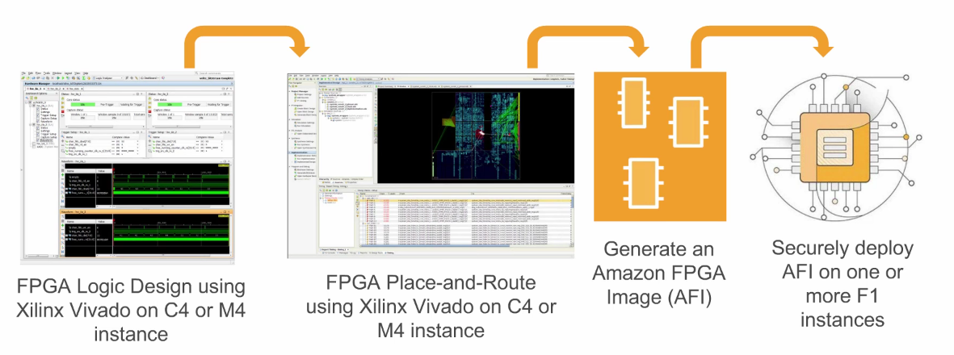
Amazon EC2 F1 Instances
Xilinx tools (Vivado Studio and SDAccel) built into the EC2 F1 AMI.
Notes:
Typically accessing an FPGA via PCIe has been a bit cumbersome. Sending data requires DMA access and knowing how best to do that programmatically.

Slide 22
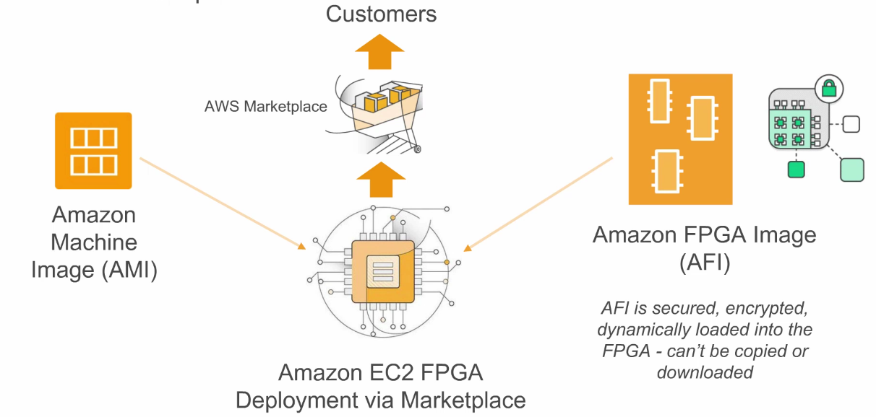
Amazon EC2 F1 Instances
Ability to republish AFIs (FPGA Images) back to AWS Marketplace.
Can also create solutions that leverage FPGAs but do not expose that functionality back to end-user.

Slide 23
Cloud-Based Use Cases
Traditional analytics – Map-Reduce paper on using FPGAs
Genomics research – highly parallel
Encryption/Cyrptography offload – in-line network encryption/decryption
Network Analysis – deep packet inspection
Machine/Deep Learning – using networks of FPGAs in unison to mimic neural networks.
Financial Analysis – market analysis; requires near real-time computation.
Video Manipulation – high throughput. (Go watch “Implementation of MITM Attack on HDCP-Secured Links”)

Slide 24
Getting Started with FPGAs
Notes:
Adoption of FPGAs by hyperscalers is picking up at a break neck pace. Moore’s law is on life support, if not already dead. We have to find other means to accelerate applications.

Slide 25
FPGA “Compilation”
High Level Languages
Hardware Description Language (HDLs)
Netlist
Configuration File
VHDL, Verilog, Lucid, PSHDL
MyHDL (Python-based)
Matlab, C, OpenCL
Hardware/Device
Mapping
Place and Route
Notes:
Two schools of thought – Use high level language – great but could be costly in terms of resources. Really should try using an HDL (know what is happening on the chip).
Called an HDL – originally was created to document ASICs (hence description language). Later they decided to use the language to automate the creation of the hardware.

Slide 26
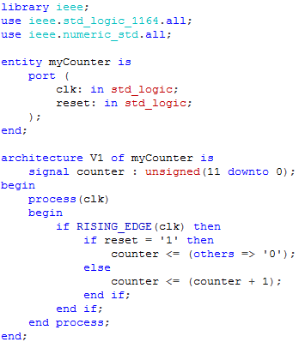
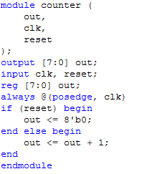
VHDL/Verilog – Code Example
Verilog
VHDL
Notes:
Easter egg – can you tell what the major difference is between both counters?

Slide 27
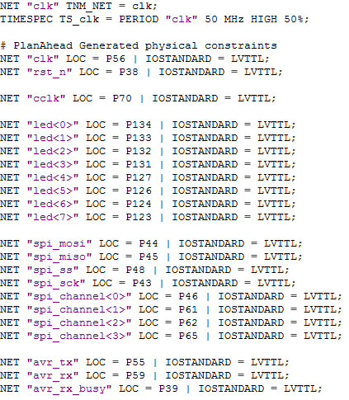
Code Packages
Include the pin and signal mapping files:
Xilinx - (UCF) – User Constraint Files.
Altera – (SDC) – Synopsis Design Construct

Slide 28
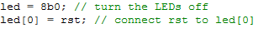
Gotchas to Watch Out For…
Be cautious of order – remember this is hardware, not software:
Compile time – you’ll have a greater affinity for the speed of a C++ or Java compiler. Map & Route can taken 5 minutes or 5 hours depending on complexity of the device.
Have a good understanding of signaling – pull up or pull down inputs and outputs; tri-state I/O; high impedance I/O
Know basic microcontroller programming – most dev tools use a uC to bootstrap the FPGA.

Slide 29
Using OpenCL for FPGAs
Provides GPU programmers easy access to FPGA programming.
Now available from major manufactures – both Xilinx and Altera have OpenCL SDKs
Work OK, but can be cumbersome with smaller devices (not as efficient)
Good for rapid prototyping and comparing performance between a GPU and FPGA.
Notes:
Maybe your not sure whether a GPU or FPGA would be a good fit for a particular application. Building it in OpenCL is a good start to figure out which might work best.

Slide 30
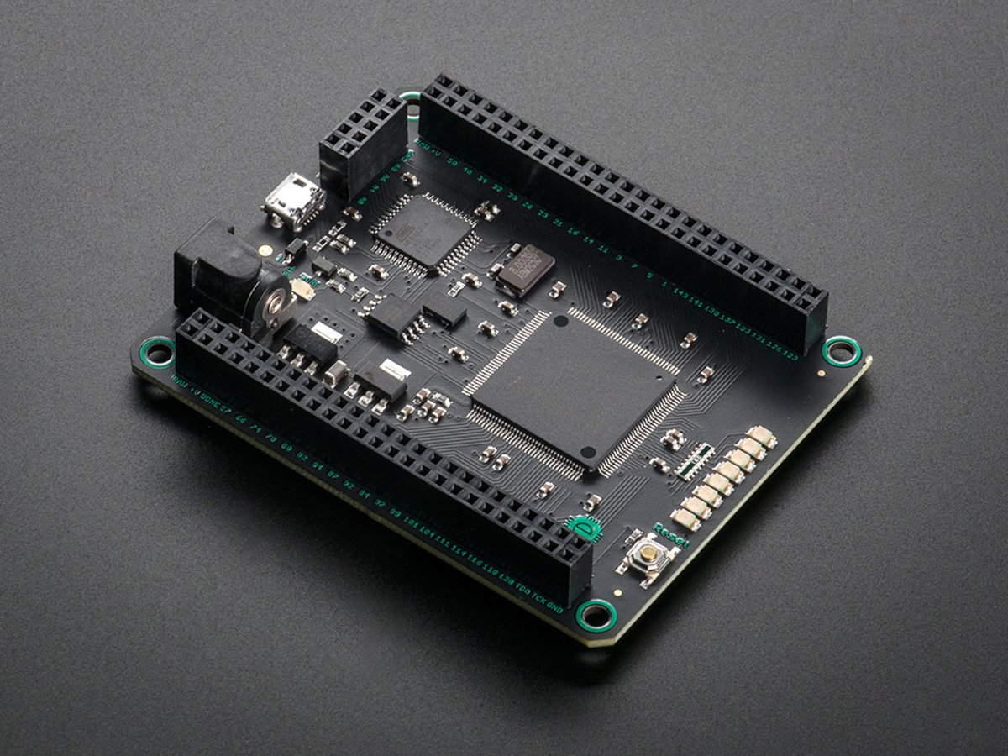
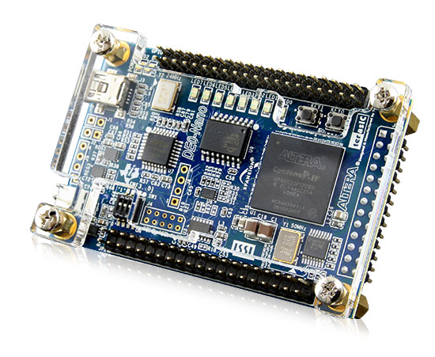
Good Development Boards
Mojo v3 by embeddedmicro.com
Xilinx Spartan-6 FPGA
Great tutorials on website
Alterative lang. – Lucid
Comes with custom IDE
Price: $59
DE0-Nano by Terasic
Altera Cyclone IV FPGA
Good tutorials all over
Price: $87

Slide 31
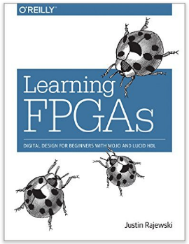
Other Resources
Intel has a good 4 hour video tutorial that leverages the DE0-Nano platform.
“Learning FPGAs” – book to be released later this spring. Tutorials use the Mojo v3 platform.
Altera has released a “FPGAs for Dummies” book about 2-3 years ago. Available for free online.

Slide 32


Slide 33


Slide 34

Continue the conversation…
See website for more info and directions
https://cloudsaturdayatlanta.com/

